Slide 1
Build a testing framework
What should we care

Slide 2
What are you thinking about ?
Migrate legacy test ?
How we apply AI to migration
Will we create new testing script on it?
Will we apply data preparation for it?
Using feature file or not?

Slide 3
Let think about it step by step

Slide 4
Define Our Goals First
Scope of Project: Migration only or we will implement new script on it?
What are you testing : E2E, UI only ?
Which tech stack: C# or Typescript ?

Slide 5
Choose the right tool
Playwright’s capabilities that match with our project:
Browser: Multi-tab, multi-context, cross-browser
Auth: Session reuse, cookies, OAuth
Visual: Screenshots, video, regression, PDF
Debug: Trace viewer, console capture, codegen
Data: API calls, DB, file up/download
MCP: browser control via accessibility tree or vision
Agent: Claude

Slide 6
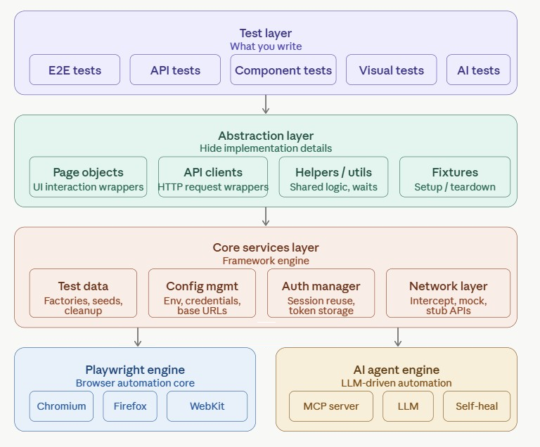
Do it the right way Architecture
Test layer is what your team writes daily — E2E scripts, API tests, component tests, visual checks, and AI-driven exploratory tests. This should feel as simple as possible.
Abstraction layer is your framework's core value. Page Objects wrap UI interactions, API clients wrap HTTP calls, Fixtures handle setup/teardown. Tests should never talk directly to Playwright — they talk to this layer. This is what makes tests maintainable when the UI changes.
Core services handle the cross-cutting concerns — test data factories, environment config, auth session reuse, and network interception/mocking. These are shared by every test regardless of type.
Playwright + AI engines sit side by side. Coded Playwright handles your stable, deterministic flows. The AI agent engine (MCP + LLM) handles exploratory, self-healing, and natural-language-driven tests. They feed into the same reporting pipeline.

Slide 7
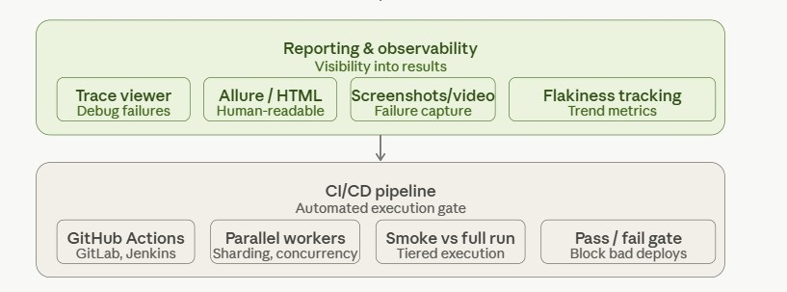
Do it the right way Architecture
Reporting gives your team visibility — Playwright trace viewer for debugging, Allure/HTML for stakeholders, video capture on failure, and flakiness tracking to keep the suite healthy.
CI/CD is the gate — fast smoke tests on every PR, full regression on merge, with parallel sharding to keep runtime reasonable.

Slide 8
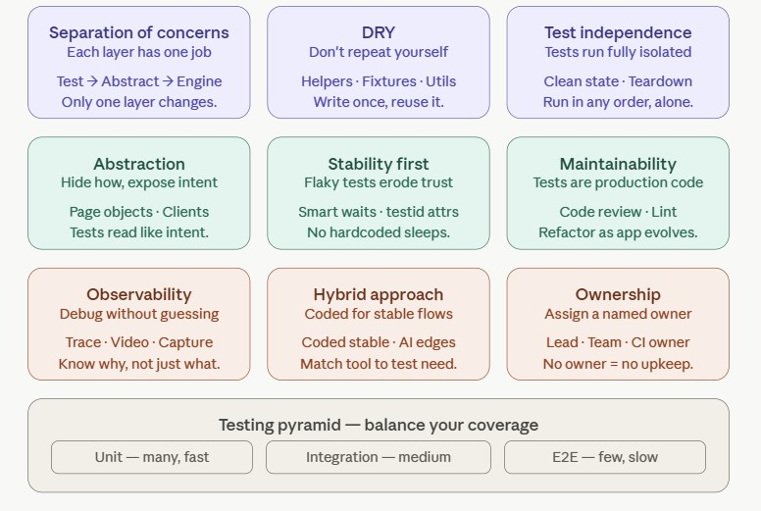
Do it the right way Key design principles

Slide 9
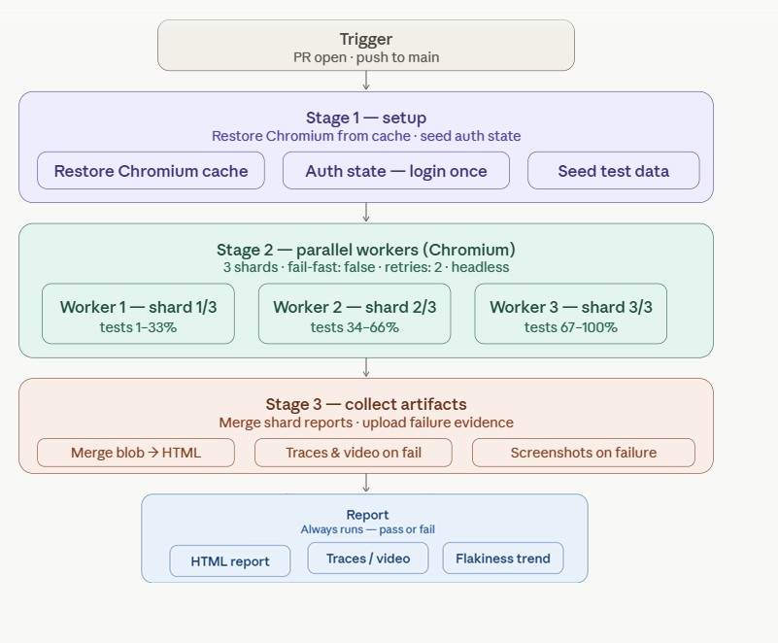
CI/CD Integration

